Slide 1


Watering Plant System
Experiment 7
Raphael S. Nano
CPE160P / B1
Computer Engineering Department
School of Electrical, Electronics, and Computer Engineering

Slide 2
Introduction: Soil Quality and Plant Maintenance
Factors that improve soil quality include sunlight, minerals, and moisture.
Depending on the plant, the moisture content of the soil may be varied.
Some may need a lot of water, while others survive in little to no water.

Slide 3
Objectives
To be able to demonstrate how an automatic watering plant system works.
To be able to apply embedded systems in maintaining the moisture in the soil of the plant.
To be able to demonstrate how the servo motor or stepper motor will function to water the plant.
To be able to apply what you have learned in Microprocessor and Logic Circuits and Switching Theory.
To be able to apply embedded system in a simple handshaking using Arduino Kit.

Slide 4
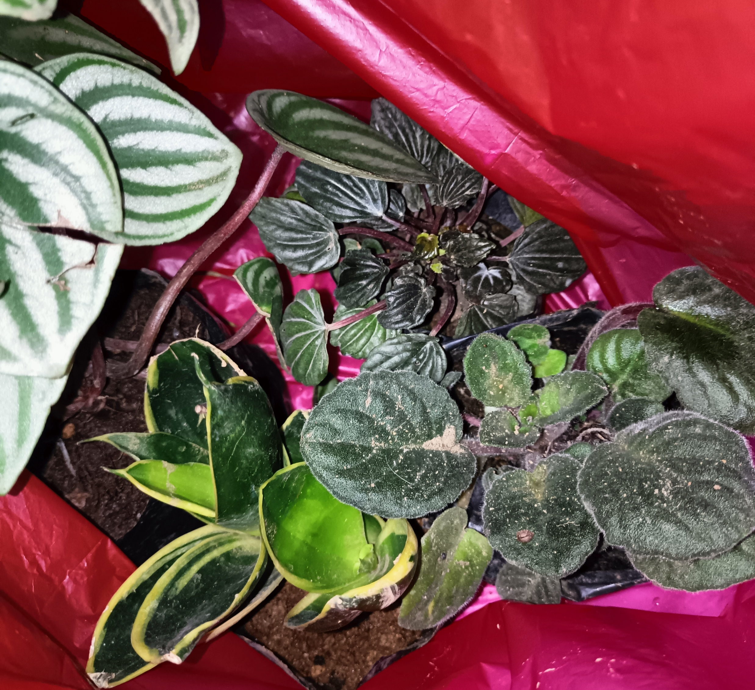
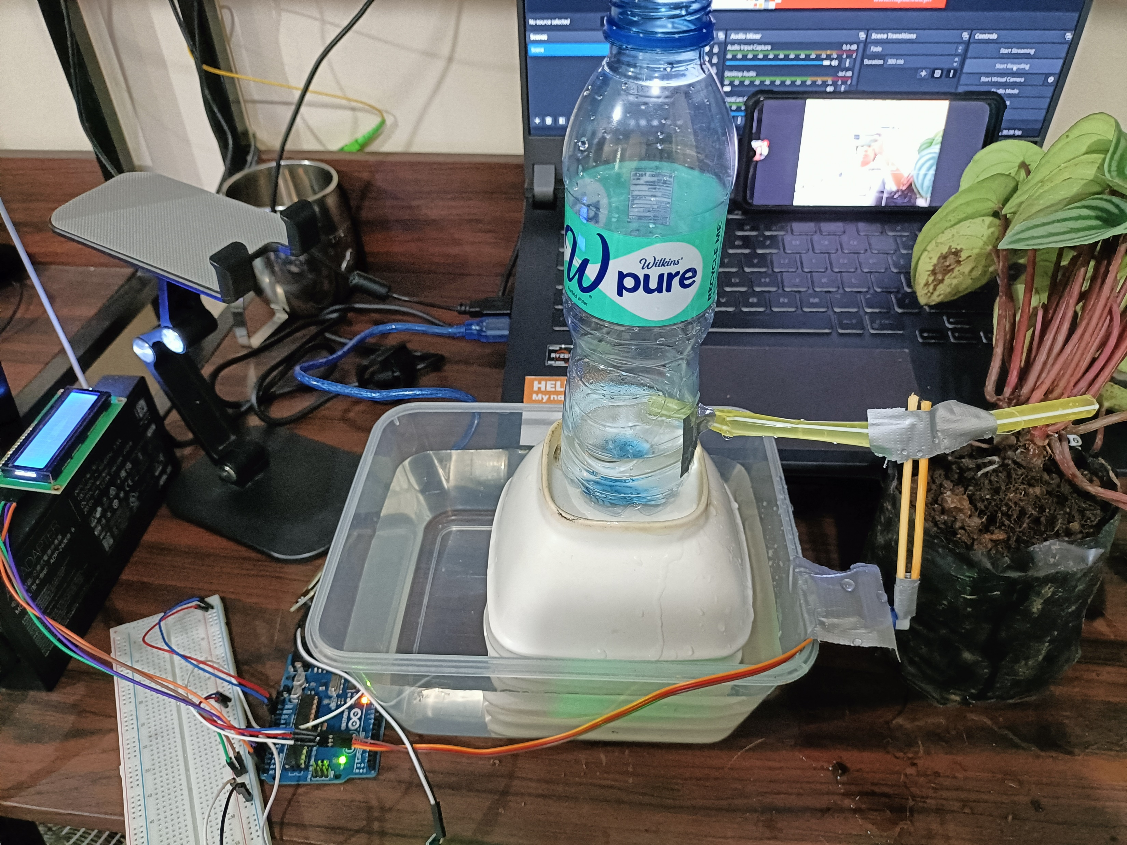
Materials
Arduino Kit
Arduino Uno
SG90 Servo Motor
QAPASS LCD
YL-100 Moisture Sensor
4 succulent plants

Slide 5
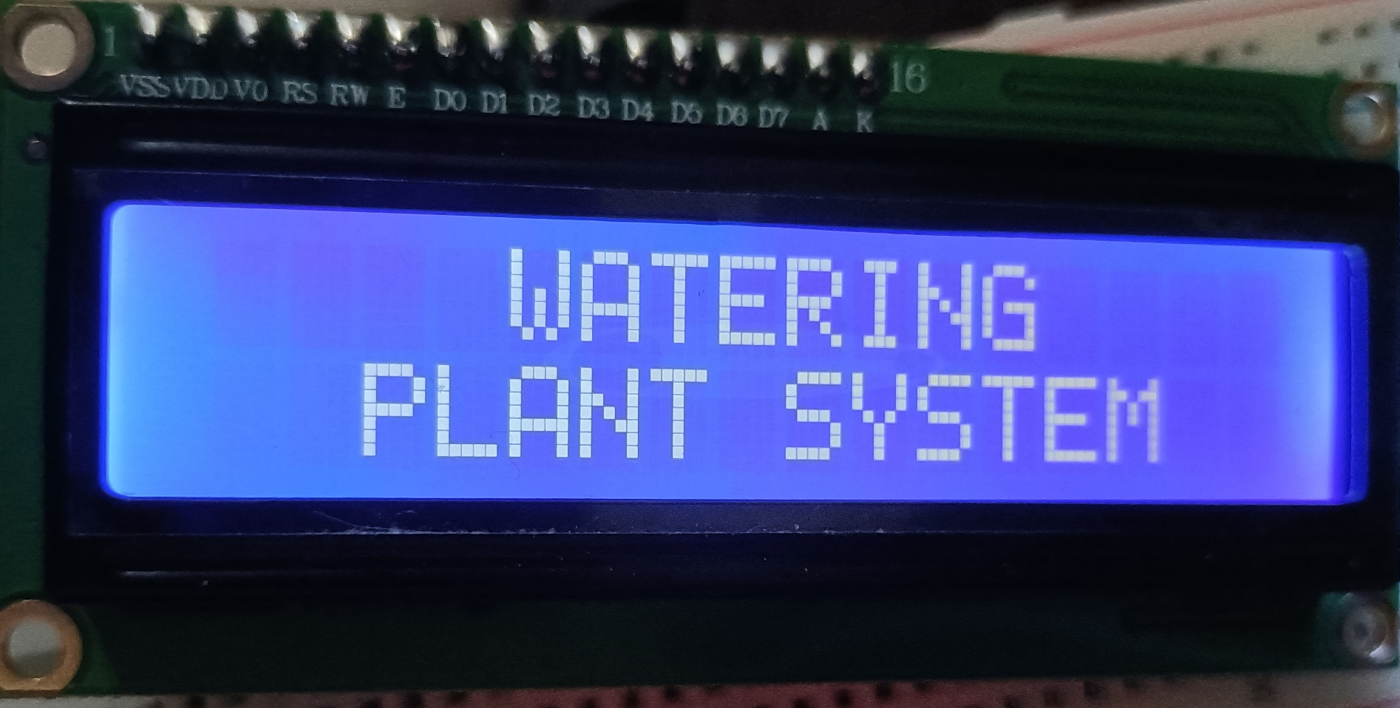
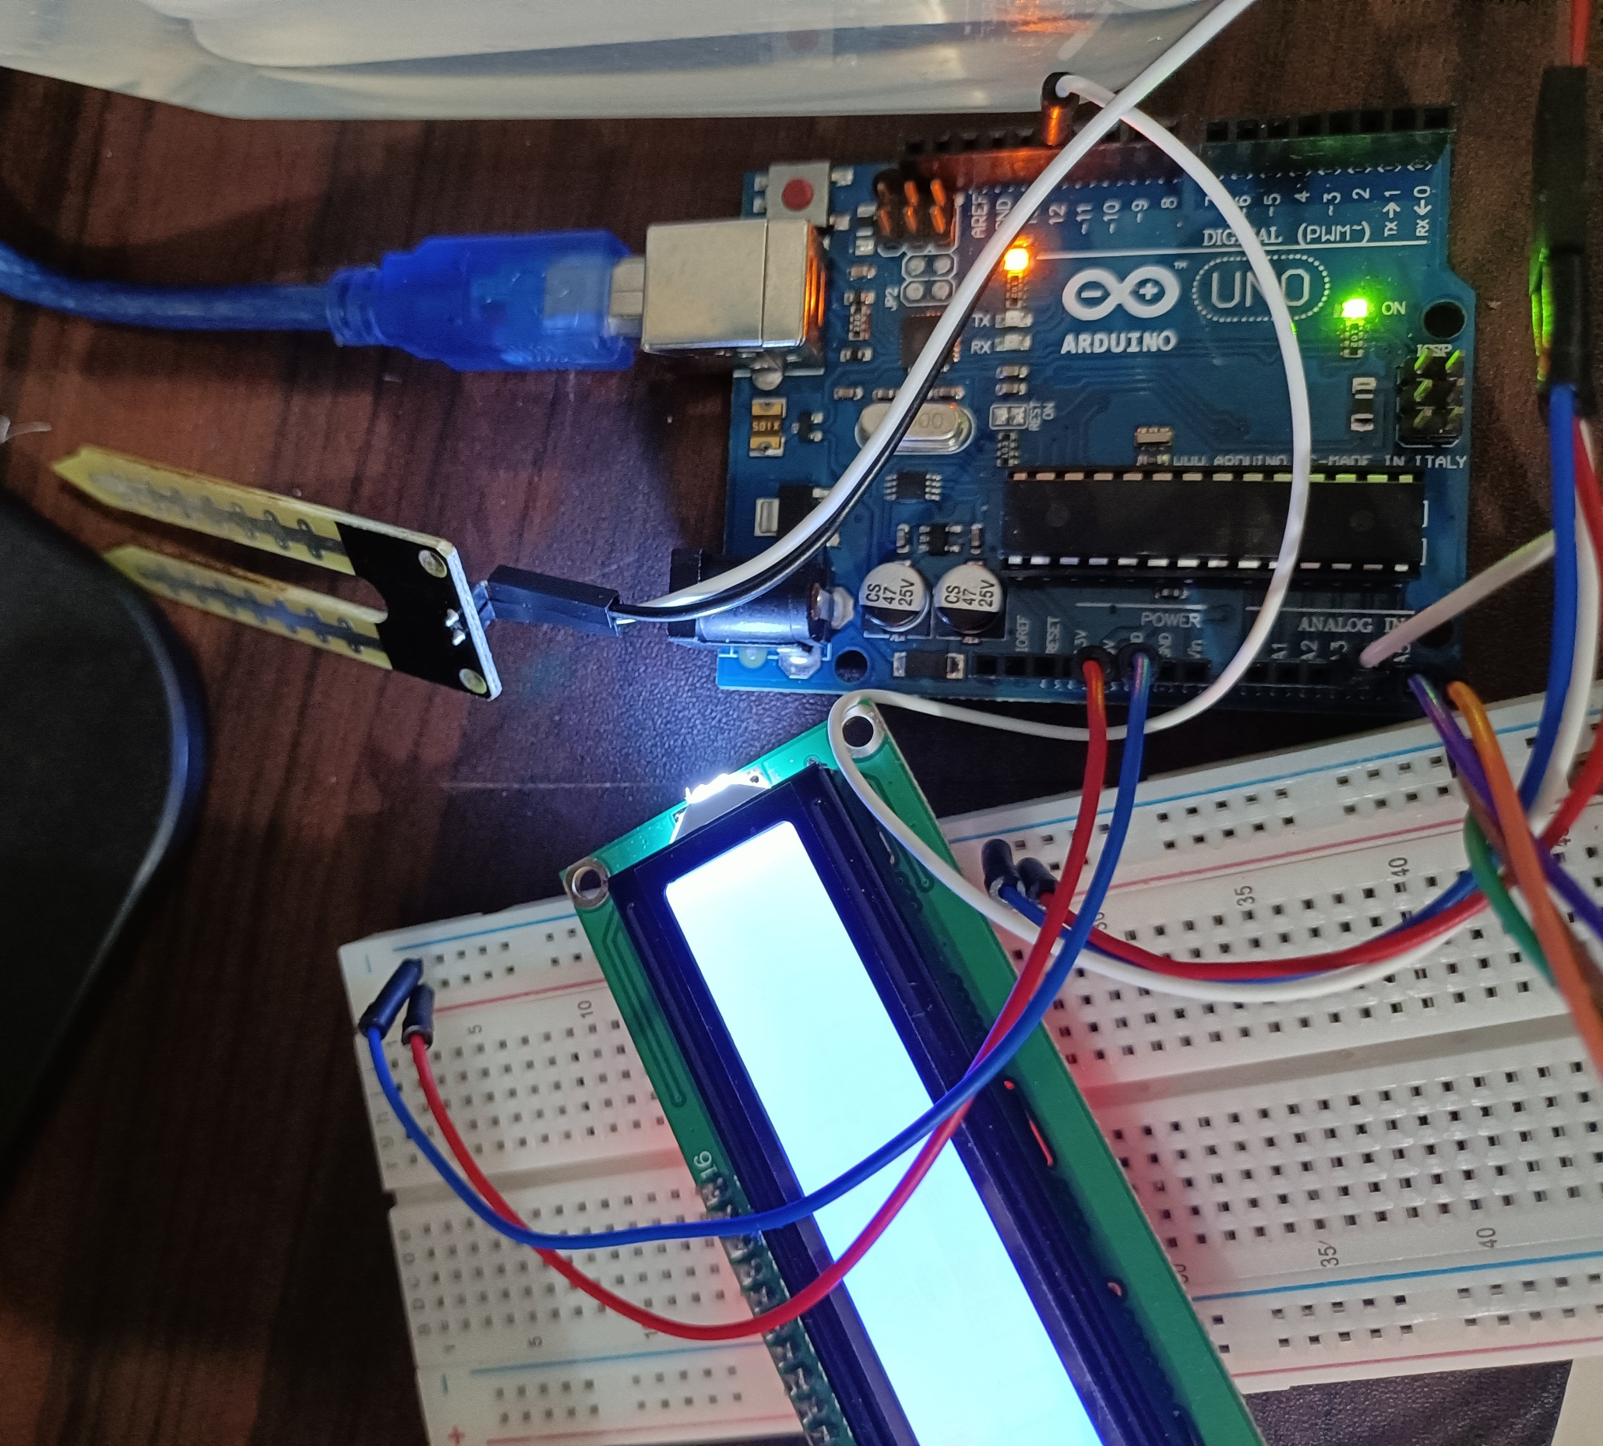
Discussion: Watering Plant System
Crucial Factors: the detection of the moisture percentage of the soil and the movement of servo motor to open and close the replicated hose.
For moisture sensor, readMoist() function was created
Moisture Percentage = (100 - ((sensor value/ 1023) * 100))
Dry: 20 to 40, Below Normal: 40 to 50, Normal: 50 to 60, Submerged or Drowning: 60 to 70

Slide 6
Discussion: Watering Plant System
For servo motor, closeHose() and openHose() functions were created
The closeHose() rotates the motor to 160 degrees, folding the straw upwards to stop water flow
The openHose() rotates the motor to 0 degrees, unfolding the straw to allow water flow

Slide 7
Discussion: Watering Plant System
For LCD, LiquidCrystal_I2C library was used
Lines in the output were also manipulated with rows and columns
Ranges and their corresponding percentages were displayed

Slide 8
Conclusion
The watering plant system works by detecting the moisture percentage of the soil, unfolding the straw to allow water flow if the soil moisture detected is Dry or Below Normal, and folding the straw if the soil moisture detected is Normal or Submerged
Through series connections, pin layouts, and sensor and motor triggering, the usage of microprocessors, logic circuits, and switching theory were illustrated.
The watering plant system was successfully developed and exhibited in a basic handshaking as an outcome of employing many variables, modules, and calling such functions to construct an embedded system.

